Slide 1


GARBAGE-GUARD
Development of Computer Vision for Creeks Garbage Detection Using Convolutional Neural Network
Brian Jay Celeste
Genesis Walter D. Reyes II
Jade C. Gunayan
King Perth G. Pepito
Rodel S. Banogbanog
Thesis Adviser: Dr. Jonel R. Macalisang

Slide 2

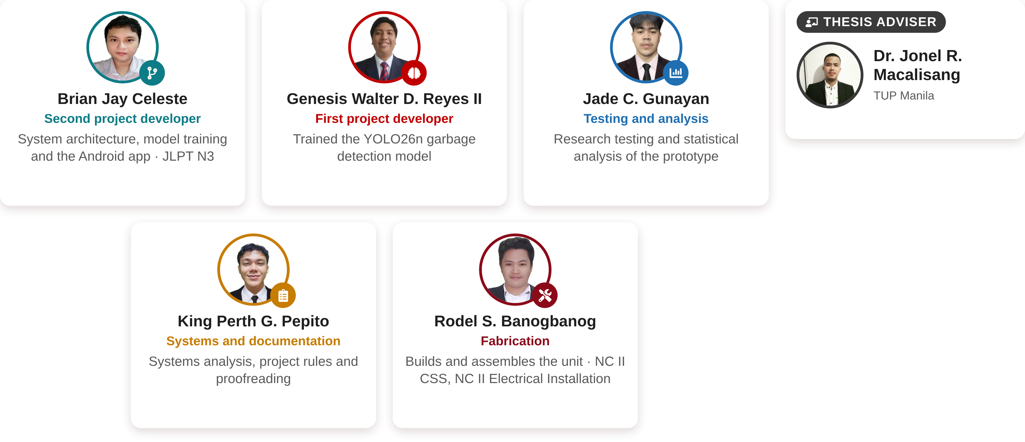

The Researchers
CURRICULUM VITAE

Slide 3
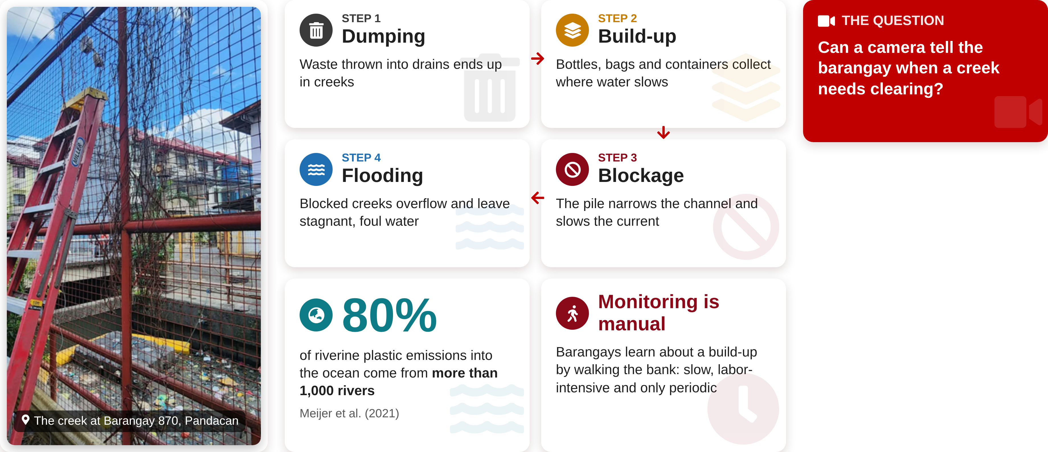
Garbage in Urban Creeks
BACKGROUND OF THE STUDY

Slide 4
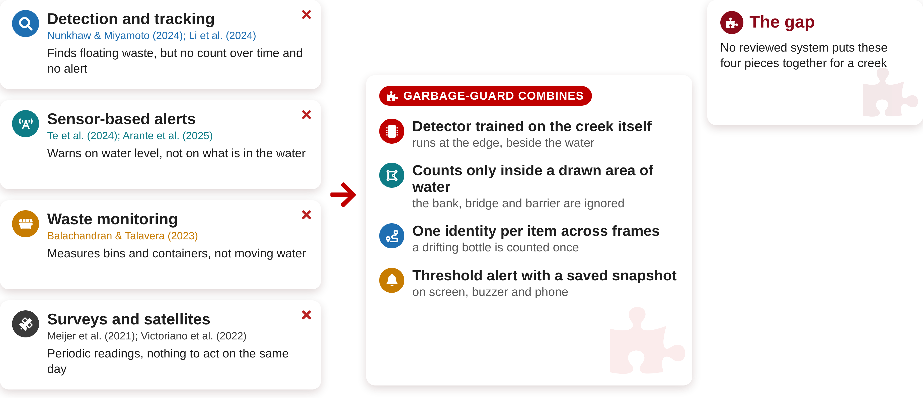
The Research Gap
BACKGROUND OF THE STUDY

Slide 5
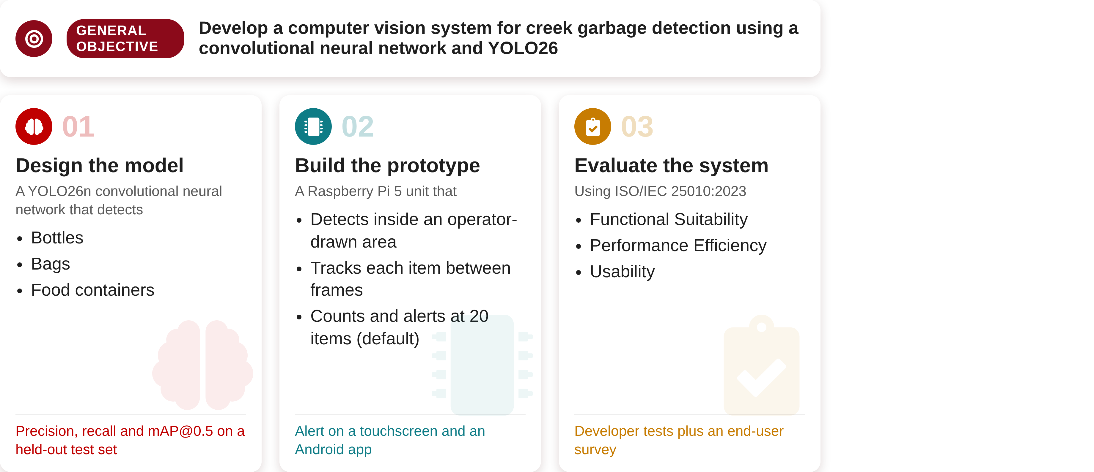
Objectives
OBJECTIVES OF THE STUDY

Slide 6
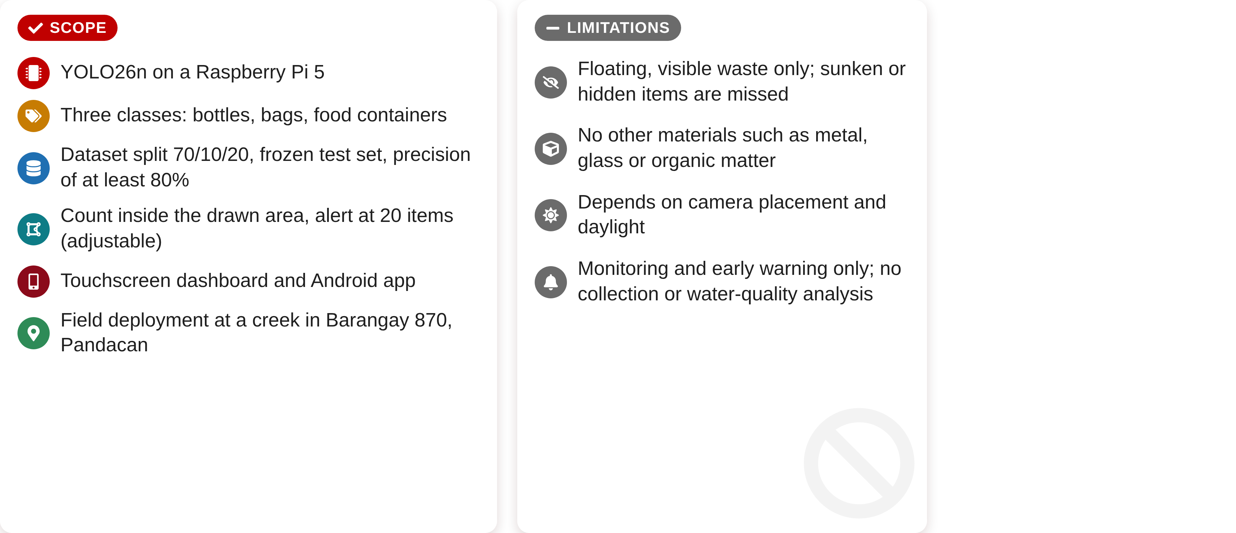
Scope and Limitations
SCOPE AND LIMITATIONS OF THE STUDY

Slide 7
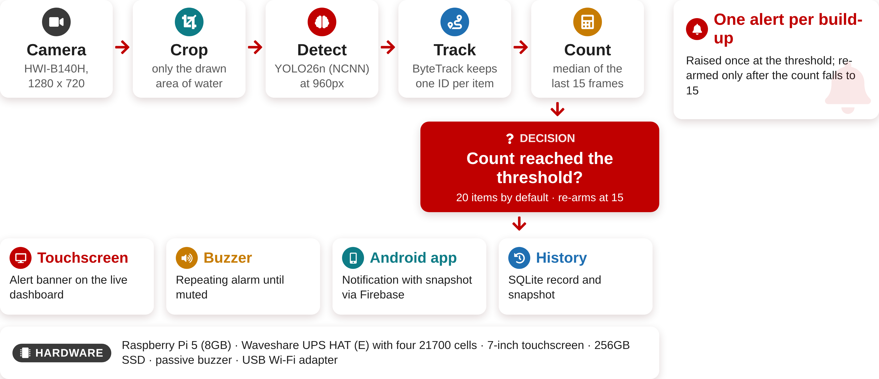
How Garbage-Guard Works
DESIGN

Slide 8
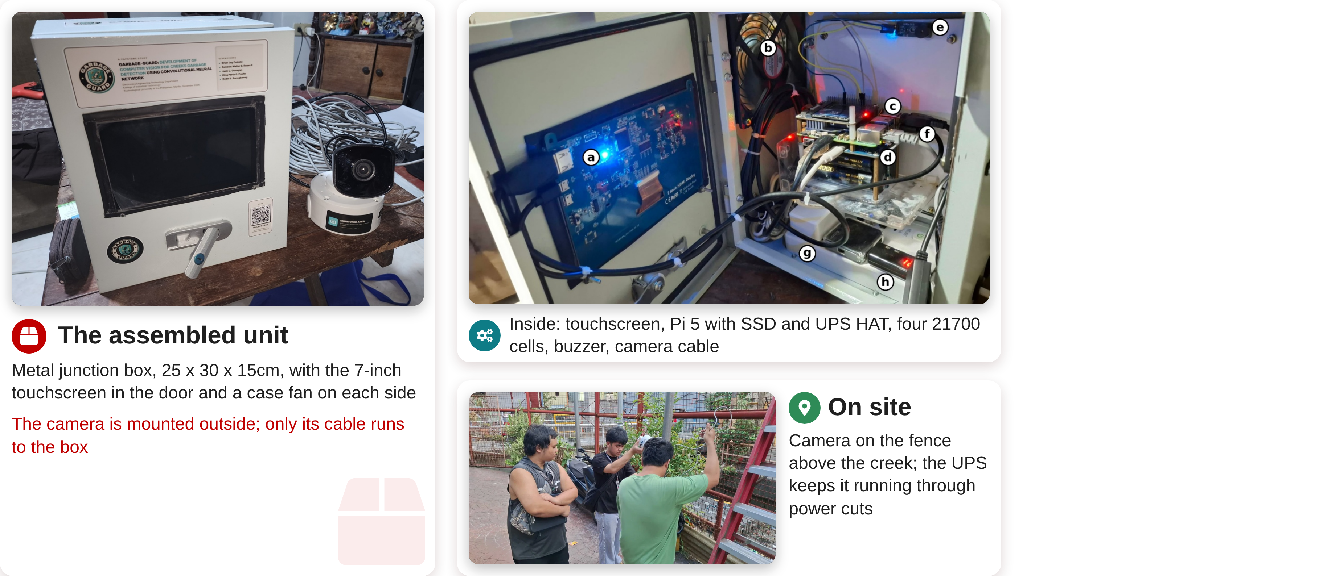
The Prototype
DESIGN/DEVELOPMENT

Slide 9
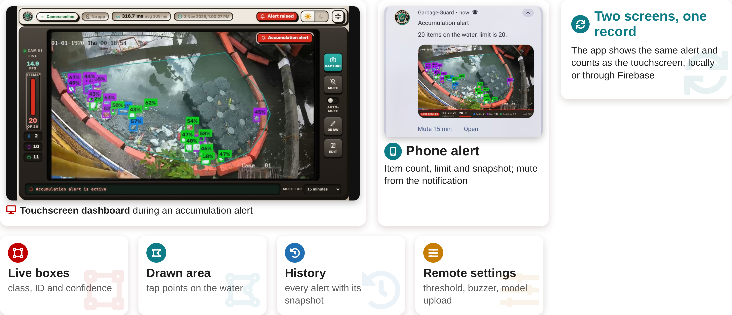
Dashboard and Mobile App
FEATURES

Slide 10
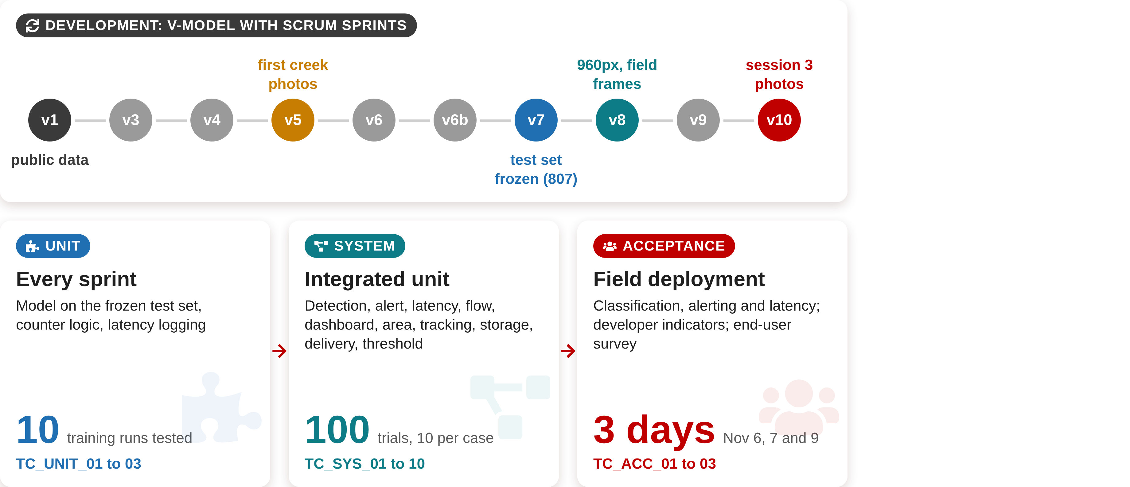
Development and Testing
TESTING PROCEDURE

Slide 11
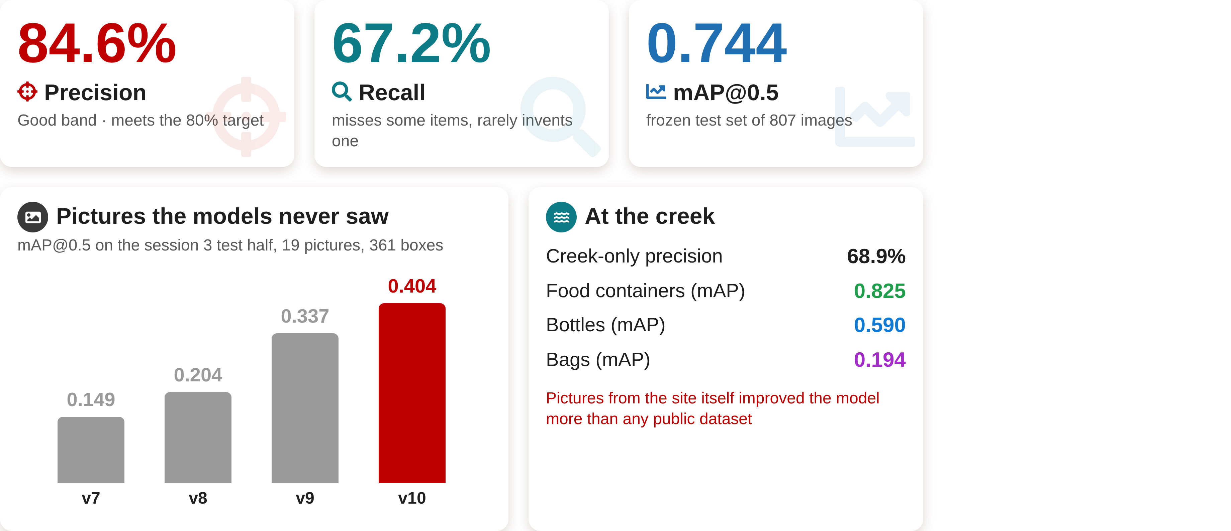
Detection Model Results
TEST RESULTS

Slide 12
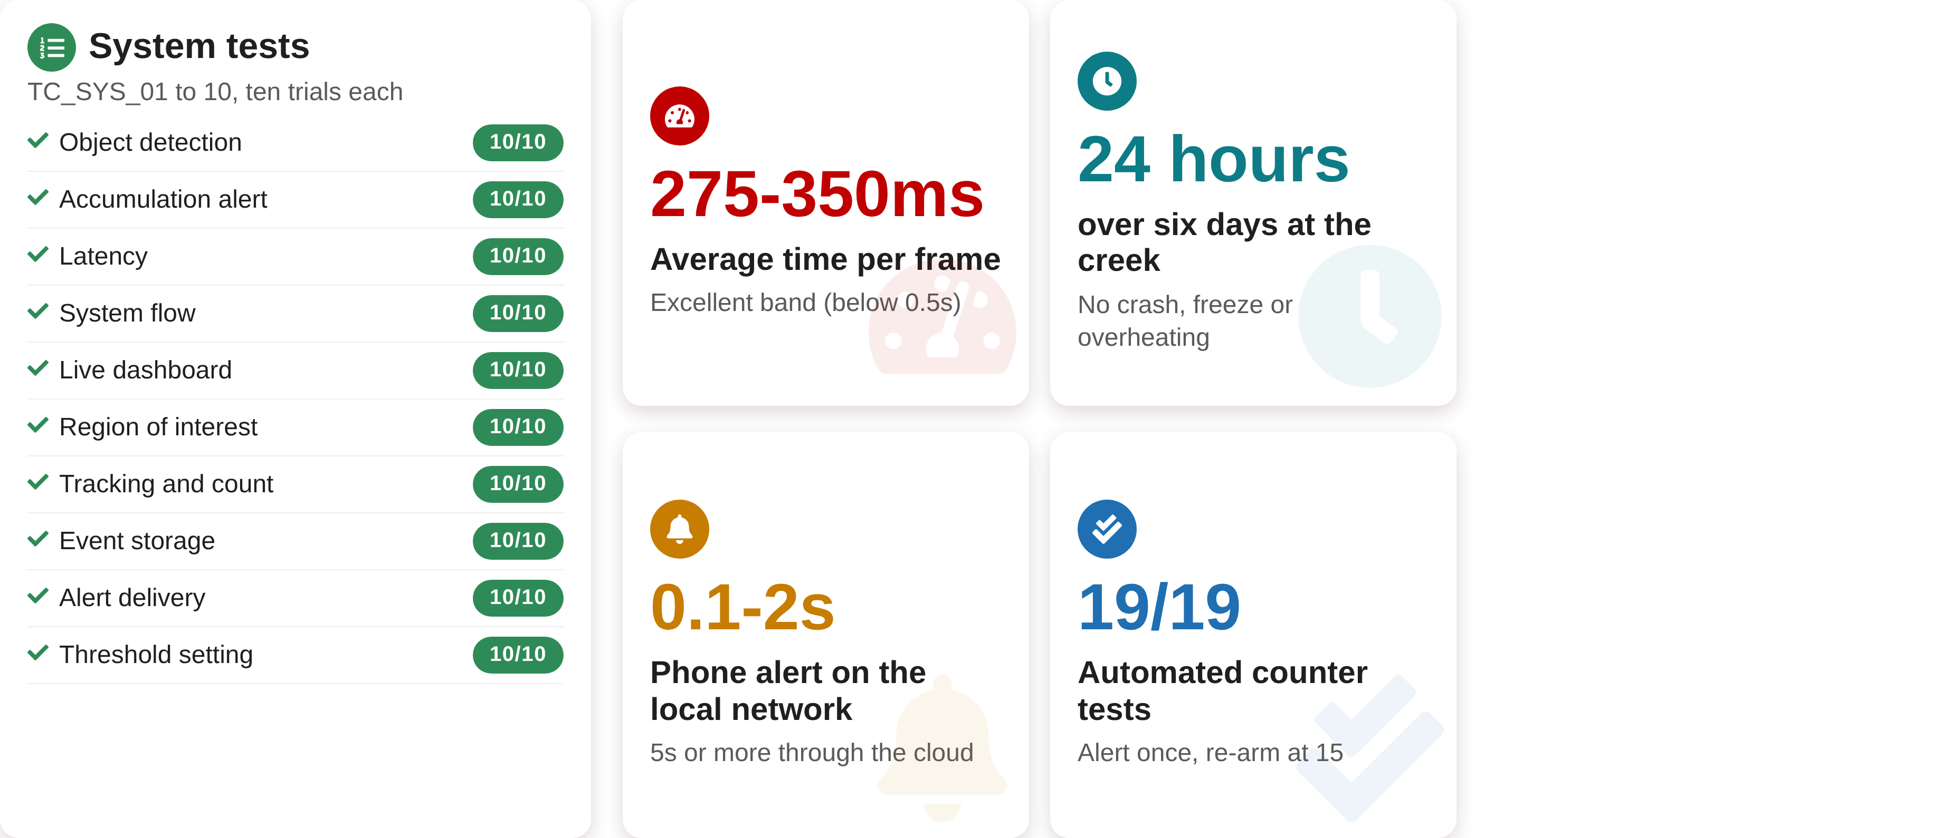
System and Field Results
TEST RESULTS

Slide 13
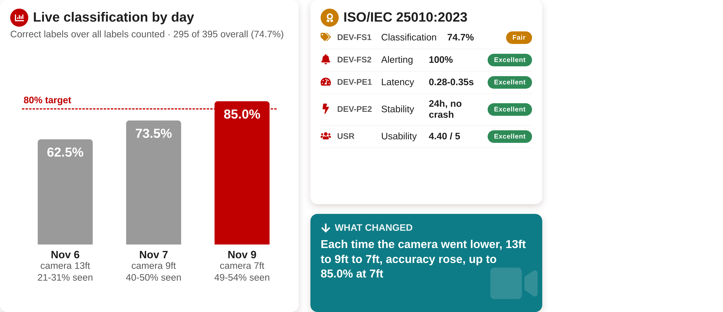
Field Accuracy and Evaluation
TEST RESULTS

Slide 14
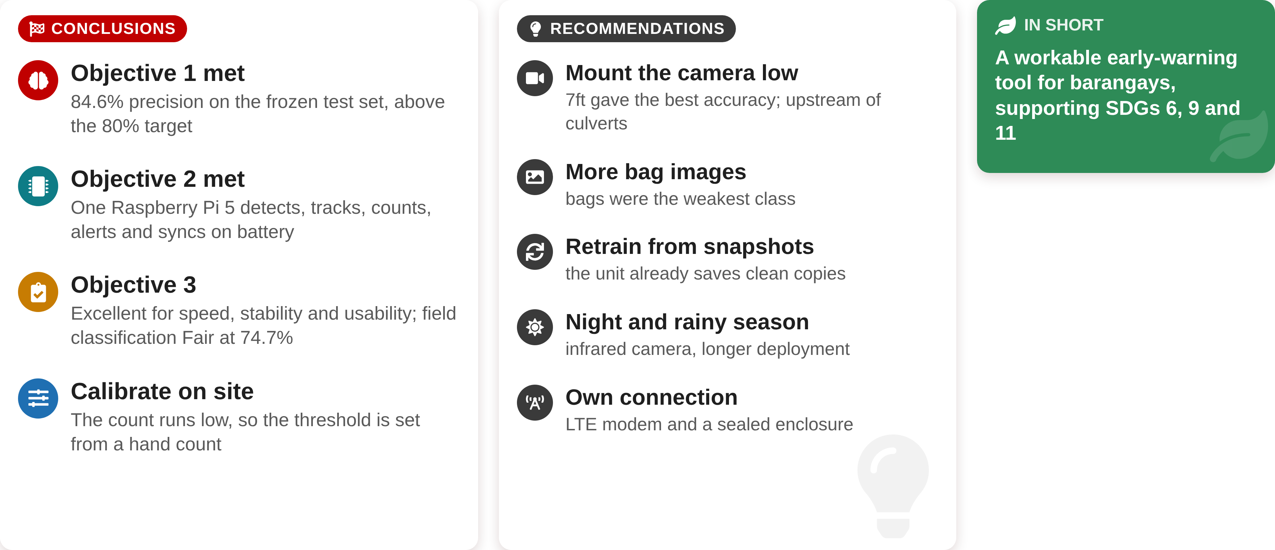
Conclusions and Recommendations
CONCLUSIONS AND RECOMMENDATIONS
CONCLUSIONS
RECOMMENDATIONS
IN SHORT
A workable early-warning tool for barangays, supporting SDGs 6, 9 and 11
1
Objective 1 met
84.6% precision on the frozen test set, above the 80% target
1
Mount the camera low
7ft gave the best accuracy; upstream of culverts
2
More bag images
Bags were the weakest class
2
Objective 2 met
One Raspberry Pi 5 detects, tracks, counts, alerts and syncs on battery
3
Retrain from snapshots
The unit already saves clean copies
4
Night and rainy season
Infrared camera, longer deployment
3
Objective 3
Excellent for speed, stability and usability; field classification Fair at 74.7%
5
Own connection
LTE modem, or LoRa for alerts and counts
6
More cameras, wireless
Several cameras per unit; wireless links
4
Calibrate on site
The count runs low, so the threshold is set from a hand count
7
Longer range
Higher-quality or zoomable camera
8
Data analytics
Trends from the stored alerts and counts

Slide 15

THANK YOU!!

